Slide 1
WELCOME TO A PRESENTATION ABOUT ME

Slide 2
ME
-My name is Ahmed Fayez Riaz.
-I’m 19 years old.
-I’m a Muslim.
-I was born in Islamabad, Pakistan.
-I’m currently studying BBA at IBA, Karachi.
-I’m the oldest of my 3 siblings.
-My Father is serving in the Pakistan Air Force.
-My Mother is a housewife.
-Throughout my life I’ve lived in various cities of Pakistan, lived two years in Australia, and one year in Turkey.

Slide 3

My Hobby
I love Playing and watching football.
I started playing when I was 8 years old.
My favorite team is Real Madrid.
I was always a part of my schools and colleges football teams.
I was Captain of Karachi Uniteds U-18 football team.
I am part of BBA’s 3,4 team in IBA.
I’m also part of PAF Base Faisals football team.

Slide 4
Languges I can speak
ME
URDU
ENGLISH
TURKISH
My Mother tongue
My second language
MERHABA

Slide 5
MY MERITS
01
02
03
04
TRUSTWORTHY
DISCIPLINED
CREATIVE
Versatile
AND MANY MORE

Slide 6
MY WEAKNESSES
I don’t have any.

Slide 7
My Goals in Life
Try to graduate from IBA.
Get an A in ICA.
Become a pilot.
Live a happy life.

Slide 8
MY EXPERTISE
Extremely Professional with Microsoft Word, Excel and PowerPoint.
I can type really well with a minimum speed of 33WPM and Accuracy of 98%.
Vast Experience in Github.
All thanks to my great Sir Muhammad Waseem Arain.

Slide 9
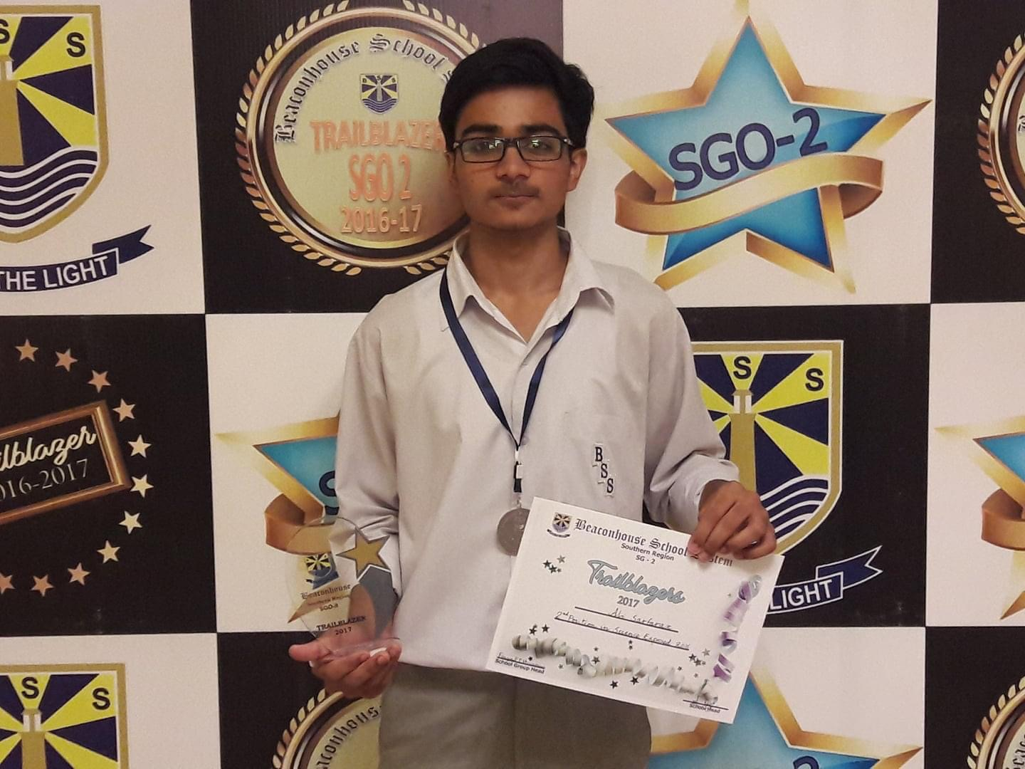
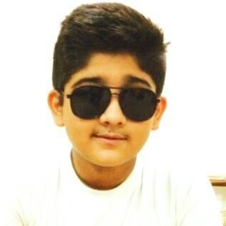
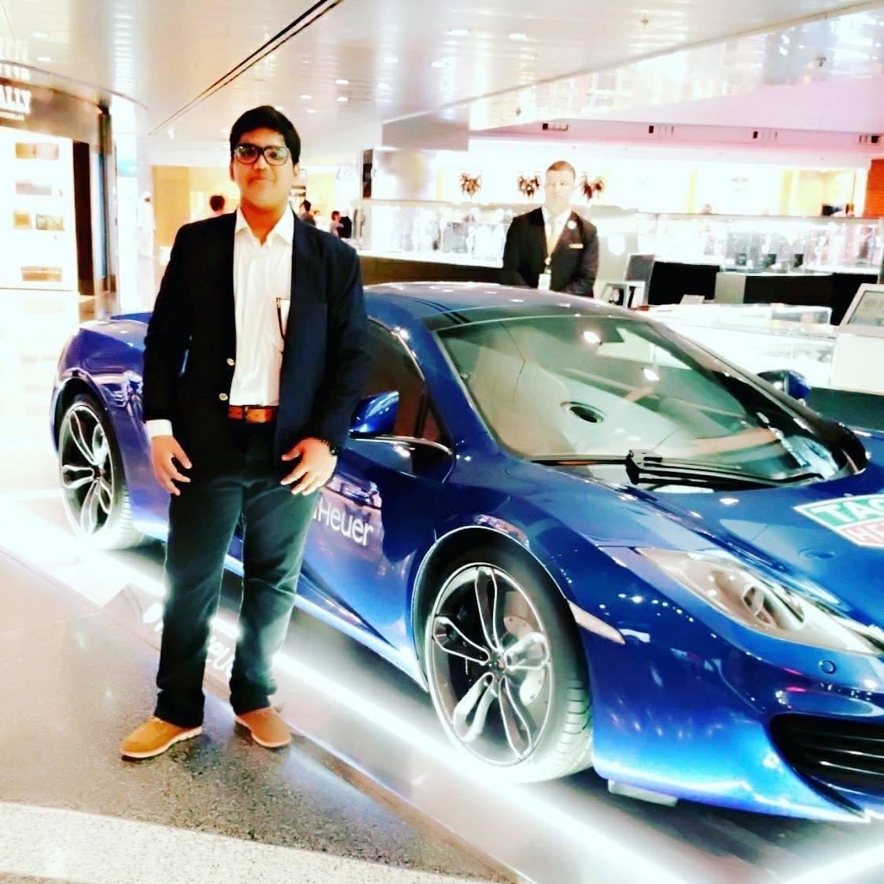
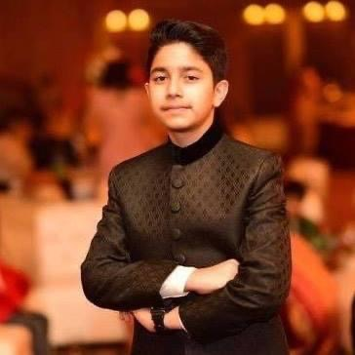
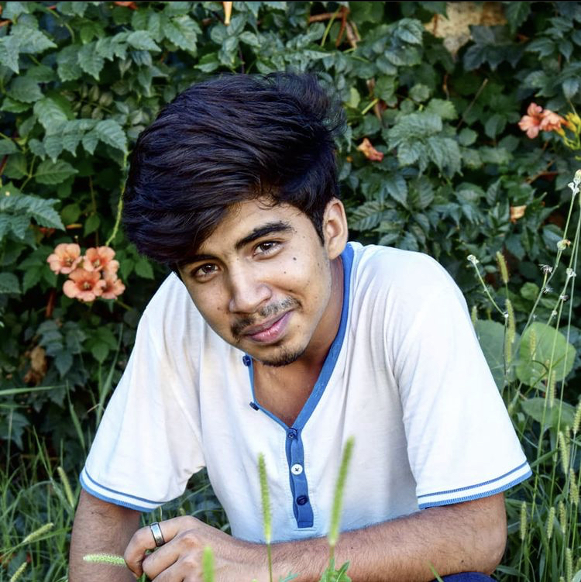
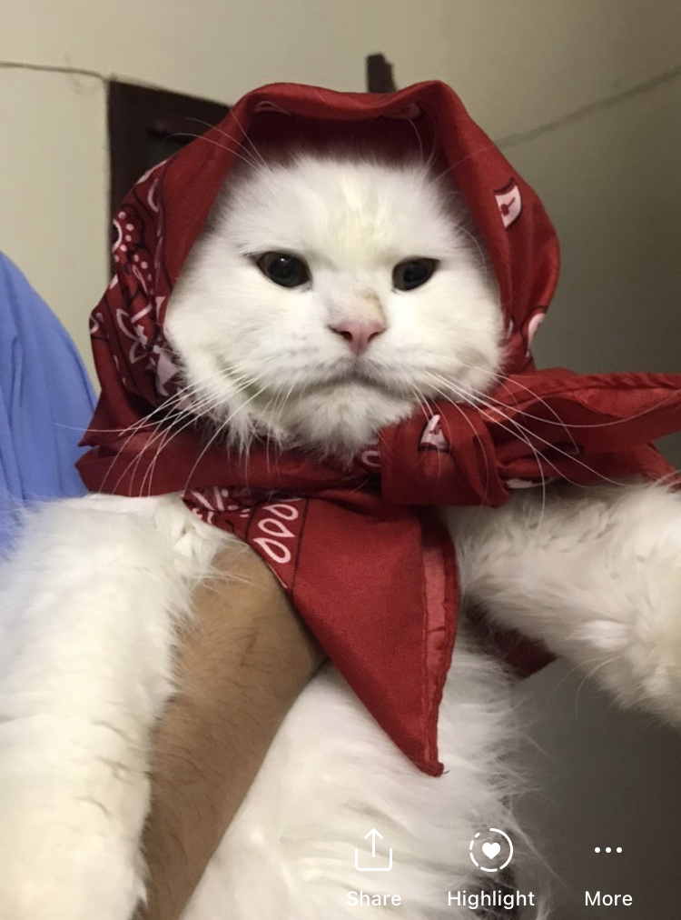
MY PETS
My sophisticated Pet
My pet who can sing
My real-estate pet
My big pet
MY REAL PET ‘MARIO’
My pet from Mansehra

Slide 10
My Epistemological and Metaphysical Beliefs
I believe that sources of knowledge should be open to all and their should be a constant struggle to learn an grow, so an individual can himself establish his meaning of life.

Slide 11
ThankYou
For
YOUR PATIENCE

